Slide 1
Interest and Dividend Income
Form 1040 – Lines 8 – 9
Pub 4012 – Tab D
Pub 4491 – Lesson – 9
Notes:
Slides 7, 8, 10 – bond interest – OOS?
#28, 29, 30, 37, 43, 54 new screen shot

Slide 2

What Is Interest Income?
Earnings on
  Bank, savings, and credit union deposits
  Certificates of Deposit
  Bonds (corporate or government)
  Money loaned out

Slide 3
Interest Income – What Is It?
It is not earned income
  Money, not a person, is earning the income
Reported in year earned
  Usually when posted to account

Slide 4
Where to Find Interest Income
Form 1099-INT or 1099-OID
Brokerage Statement
Schedule K-1 (see K-1 lesson)
No tax form from payer
  Seller financed mortgage interest income
  Private or foreign payer
  Interest less than $10
Notes:
Credit unions may call their interest “dividends” – but it’s really interest and reported as such

Slide 5
Interest Income
Whether or not reported by the payer on a tax form, all interest must be included in the return
  Taxable
  OR
  Tax-exempt
  Other calculations can be impacted

Slide 6
Interest Income
All interest is taxable except interest from
  State or municipal obligations; including
    D.C.
    U.S. possessions
    See Pubs 4491 and 4012 for others
U.S. obligations (T-Bills, Savings Bonds, etc.) are fully taxable for federal tax but exempt from state tax
Notes:
Informational:
Some treasury bonds may produce exempt interest for federal purposes
Certain “EE” or “I” bonds used for qualified education purposes
Requires Form 8815 – which is out of scope

Slide 7
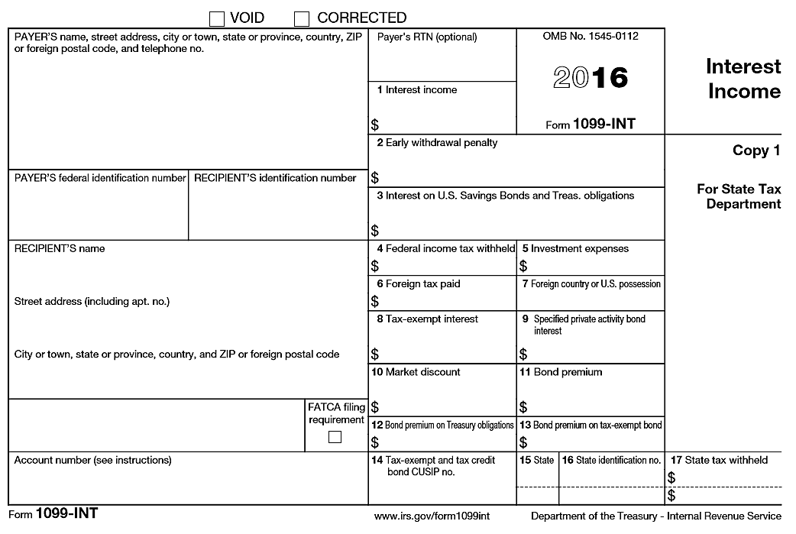
Interest Income
The Tax Form
OOS
OOS
FATCA is out of scope
OOS
OOS
Notes:
FATCA stands for Foreign Account Tax Compliance Act.

Slide 8
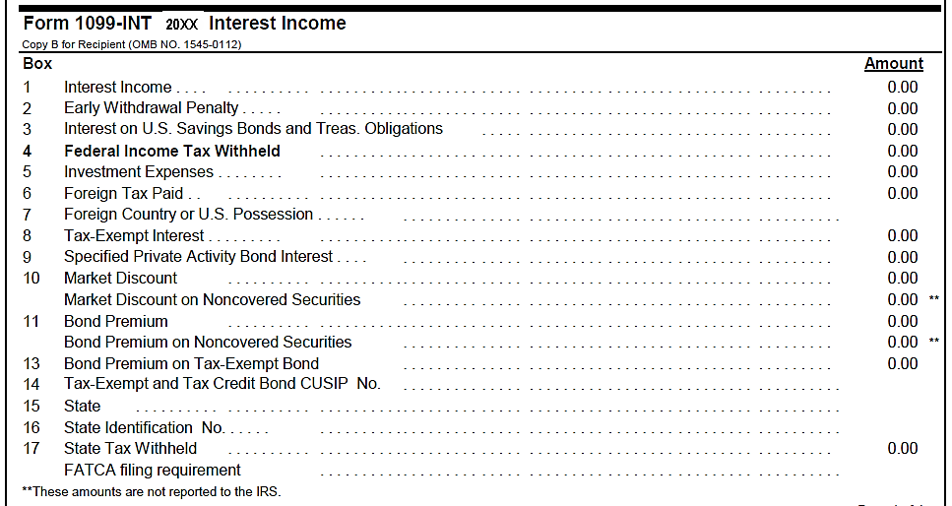
Interest Income
Interest – Excerpt from Sample Brokerage Statement
Possible itemized deduction
Lines 10-13 are out of scope
FATCA is out of scope
Notes:
Emphasize
All the information as in 1099-INT boxes
Format varies by payer

Slide 9
Bond Premium or Discount – What Is It?
Bonds can be purchased at a discount or with a premium
  The discount is additional interest income
  The premium is a reduction of interest income
Both amortized over the life of the bond
Brokers now must report the total interest income on new purchases
Notes:
Informational
Discount is if bought at less than face value
Premium is if bought at more than face value
Emphasize
If taxpayer buys and sells bonds, they should be referred to a paid preparer

Slide 10
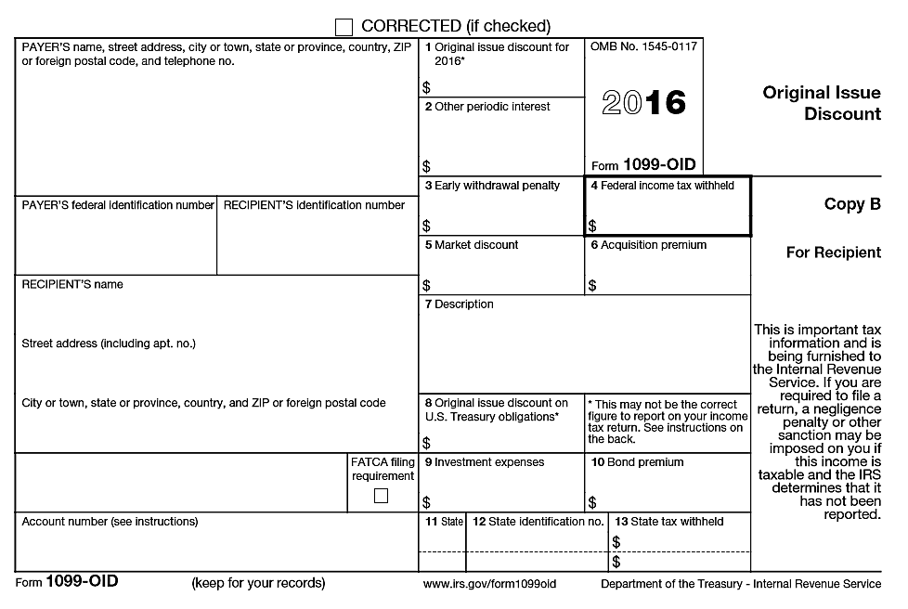
Original Issue Discount (OID)
OOS
OOS
FATCA is out of scope
OOS

Slide 11
Dividend Income –
What is it?
Payment by a corporation
Paid to its shareholders
Represents a portion of the corporation’s earnings

Slide 12
Dividend Income –
What is it?
Mutual funds* invest in (buy)
  Stock of corporations
  Bonds issued by private or government entities
  Other investments
*Includes ETFs (Exchange Traded Funds)
*Master limited partnerships are usually out of scope
Notes:
Master limited partnerships can generate ordinary income, other types of out-of-scope income, or involve substantial calculations
Additionally, they can require multiple state filings

Slide 13
Dividend Income –
What is it?
Mutual funds “pay” to their investors
  Dividends from the fund’s income
    Dividend income from corporations
    Interest income from bonds/accounts
  Capital gain distributions from capital transactions that the fund makes

Slide 14
Dividend Income –
What is it?
Mutual fund dividends
  Dividend income from corporations
    Will be identified as ordinary/qualified
  Interest income from bonds/accounts
    Will be identified if from U.S. obligation
    Will be identified as exempt if from exempt securities, e.g. state bonds
  But both are still “dividends” to the fund’s shareholders

Slide 15

Dividend Income
Ordinary dividend income, not qualified
  Taxed at regular tax rates
Qualified dividend income
  A subset of ordinary dividends
  Taxed at capital gain rates
Notes:
Emphasize
Capital gains may be taxed at a lower rate than ordinary income
Rate can be as low as zero

Slide 16
Where to Find Dividend Income
Form 1099-DIV
Substitute 1099-DIV (brokerage or mutual fund statement)
Schedule K-1 (later Lesson)
Notes:
Emphasize
Many taxpayers have direct investments, not held in a brokerage account
Extra care is needed to make sure all are accounted for

Slide 17
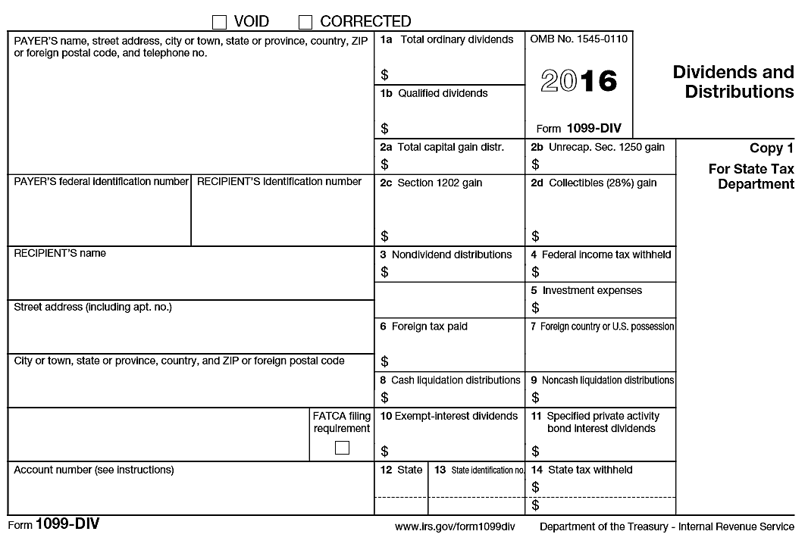
Dividend 1099
The Tax Form
OOS
OOS
OOS
OOS
FATCA is out of scope
Notes:
Box 5 Investment expenses rarely seen on 1099-DIV form; more common with a brokerage statement

Slide 18
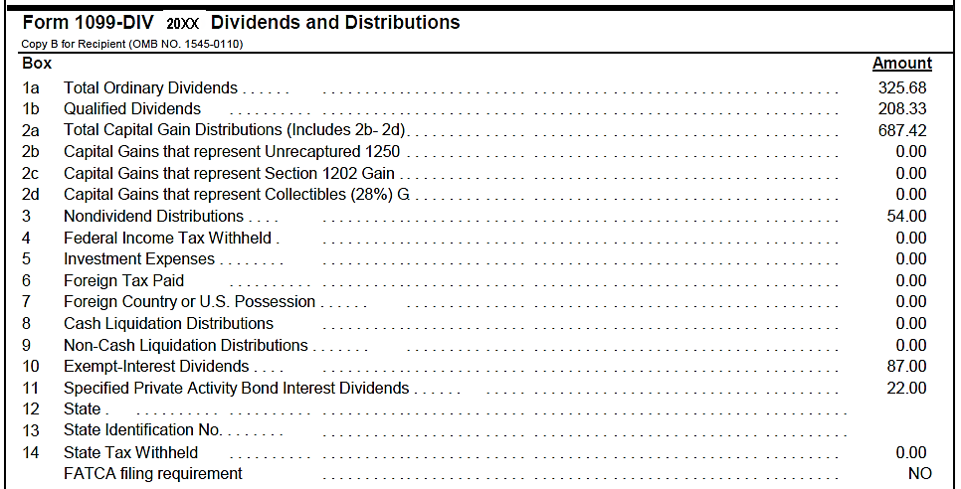
Dividends – Excerpt from Sample Brokerage Statement
20XX
Excerpt from sample brokerage statement
Lines 2c and 2d are out of scope
Possible itemized deduction
Lines 8 and 9 are out of scope
FATCA is out of scope
Notes:
Emphasize
Same as boxes on 1099-DIV
Box 2c Sec 1202 gains – out of scope
Boxes 8 and 9 Liquidation distributions – out of scope
Look out for state withholding

Slide 19
Dividend Income 1099-DIV
1a Ordinary dividends
  1b Qualified dividends – a subset of ordinary dividends
2a Capital gain distributions
  2b Sec. 1250 gain – a subset of capital gain distribution
  2d 28% gain – a subset of capital gain distribution
Notes:
Emphasize
1a, 1b and 2a are usually what we encounter

Slide 20
Capital Gain Distributions
Capital Gain Distributions represent share of profit from sale of assets within mutual fund
  Always long term
  Taxed at capital gain rates
Notes:
If fund distributes short term gains, they are treated as dividends for federal tax purposes

Slide 21
Reinvested Dividend Income
Reinvested dividends
  Really, two transactions
    Dividend income
    Purchase of more shares
  Payer effects both instantaneously
Payers keep track of basis for covered securities (always taxpayer’s responsibility)
Notes:
Reinvestment plans are sometimes referred to as “DRIPs” – Dividend Reinvestment Plans
Most often seen with mutual funds or ETFs
Can also be done with direct shareholdings
Many large companies offer DRIPs to their shareholders
1099 will be issued for the dividend amount

Slide 22
The Interview
A conversation
Notes:
Encourage counselors to ask probing questions
It is not “prying,” it is essential to an accurate return

Slide 23
The Interview – A Conversation
Prior year’s return
Forms 1099-INT, -OID, -DIV, or substitute
  Organize them by type
Forms K-1 (limited) – see K-1 lesson
Notes:
Steps and questions to determine whether in scope, before touching the computer
Prior year’s return
Review all income areas to understand the taxpayer’s tax situation
Most taxpayers’ situation does not vary much year to year
Form 1099
Look for out of scope issues
Look for foreign payers
Forms K-1
Look for out of scope items

Slide 24
Limitations on Scope – 1099-INT
Review Forms 1099-INT or 1099-OID for out-of-scope:
  Market discounts
  Bond premium
  FATCA filing requirement

Slide 25
Limitations on Scope – 1099-DIV
Review Forms 1099-DIV for out-of-scope:
  Sec. 1202 gain (small business stock)
  Collectibles
  Liquidating distributions
  FATCA filing requirement

Slide 26
Limitations on Scope –
Investment Income
Would there be any Net Investment Income Tax? (out-of-scope)
Applies only if Adjusted Gross Income is more than:
  MFJ or QW: $250,000
  MFS: $125,000
  Single or HoH: $200,000
Notes:
In general, investment income includes, but is not limited to:
interest, dividends, capital gains,
rental and royalty income,
non-qualified annuities,
income from businesses involved in trading of financial instruments or commodities (OOS), and
businesses that are passive activities to the taxpayer (OOS)
The gross investment income is reduced for investment expenses
The tax applies on the lesser of net investment income or the amount by which AGI exceeds the thresholds above

Slide 27
Entering Interest or
Dividend Income
Use
  Quick File
  Summary/Print view (line 8)
  Taxpayer profile (if set up)
  Form search box
To navigate TaxSlayer

Slide 28
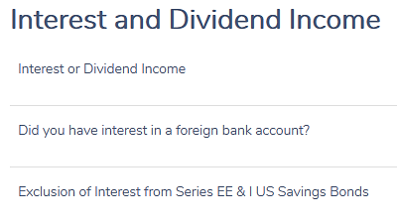
Entering Interest or
Dividend Income
Get to Interest and Dividend Income screen
Select first item
Foreign accounts – may be OOS
Exclusion - OOS

Slide 29
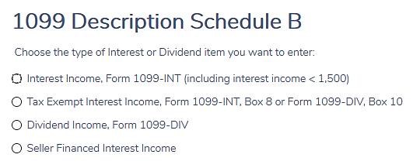
Entering Interest or
Dividend Income
Select type of income
Also use for 1099-OID

Slide 30
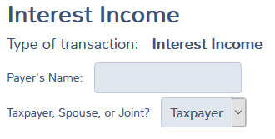
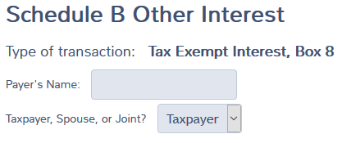
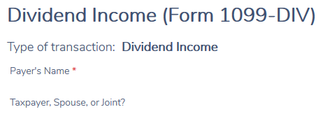

Interest or Dividend Income
Abbreviate payer name if needed
Taxpayer, Spouse or Joint (if needed in your state)
Notes:
Emphasize
TSJ if relevant to your state
Can list same payer multiple times if different types of interest, i.e.,
One line for municipal interest with state impact
Second line for Savings bonds, also with state impact

Slide 31
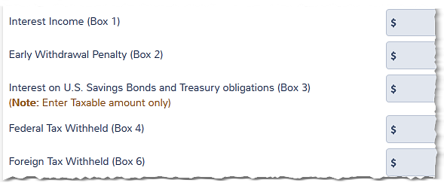
Interest Income Screen
Input data from tax form
Any tax withheld?
Foreign taxes covered in lesson #29
Notes:
Enter federal or foreign tax withheld

Slide 32
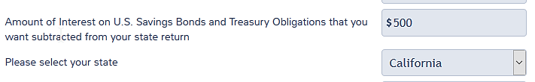
Interest Income Screen
If from U.S. obligations, subtract for your state (select state)
Notes:
Interest from US obligations is taxable for federal
Except if qualified as for education expenses – out of scope

Slide 33
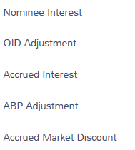
Interest Income Screen
Rest of form is out of scope

Slide 34

Entering Interest or Dividend Income
Continue to save entries

Slide 35
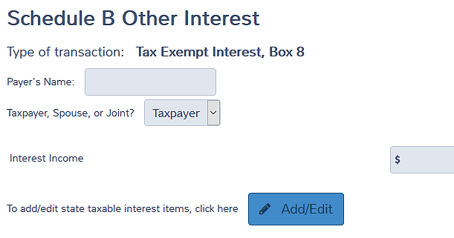
Exempt Interest or Dividends
State or municipal obligations
Is it wholly or partly taxable for state?
Notes:
Emphasize
Must enter exempt income
Not taxed
Affects other calculations, e.g. taxable part of SS benefits
Advise for your state if an adjustment would be appropriate

Slide 36
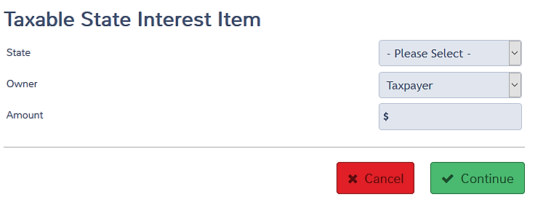
Exempt Interest –
State Adjustment
State or municipal obligations
Usually, taxable if from another state
Select your state and amount to add back to income
Notes:
Generally,
Interest income from obligations of your resident state are not taxable in your state
Interest income from obligations of another state are taxable
Indicate owner, if needed

Slide 37
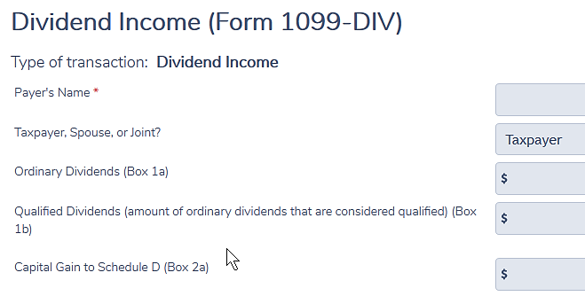
Entering Dividend Income
Generally, this is all we see/need

Slide 38
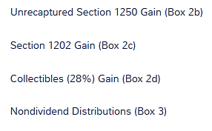

Dividend Income
TaxSlayer handles
Out of scope
Out of scope
Doesn’t go anywhere

Slide 39
Dividend Income
Nondividend distributions
  Return of basis (cost)
  Basis in paying security is reduced by amount of nondividend distribution
Payers keep track of basis for covered securities (always taxpayer’s responsibility)
Notes:
Definition of “covered securities” generally
Stock purchased in 2011 and later
Mutual fund shares purchased in 2012 and later
Other securities (options, bonds, etc.) have later “covered” dates
TaxSlayer has a place to enter nondividend distribution, but it doesn’t go anywhere

Slide 40

Dividend Income
Federal or foreign tax?
Out of scope
Foreign tax credit or deduction for foreign taxes covered in a later lesson

Slide 41
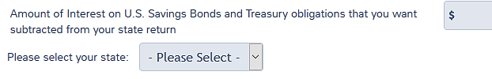
Dividend Income
US obligation income exempt for state?
Notes:
Federally exempt income – interest or dividends are entered in the exempt income screen shown earlier

Slide 42
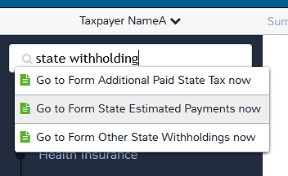
Interest or Dividend Income –
State Tax Withheld
State tax withheld? – input now
Or go to Payments and Estimates Screen
Search “state withholding” and select

Slide 43
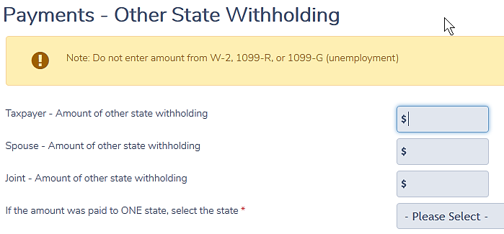
Interest or Dividend Income –
State Tax Withheld
Select your state
Carries to Sch A and state return

Slide 44
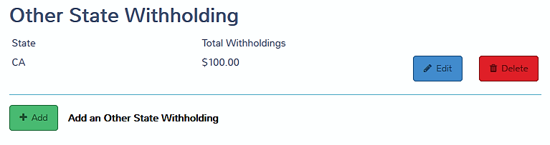
Interest or Dividend Income –
State Tax Withheld
Can add more state withholdings
Don’t duplicate state tax from W-2, 1099-R or 1099G

Slide 45
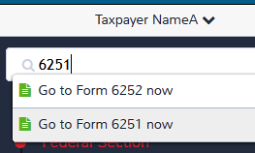
Interest or Dividend Income
Private activity bond interest?
  Click line 45 in Summary/ Print or search 6251
  Input on Form 6251
May generate alternative minimum tax
  If so, out of scope
  Check Line 45 in Summary / Print view
Notes:
If any PAB entry, need to check AMT (1040 line 45) – IF >0 OUT OF SCOPE

Slide 46
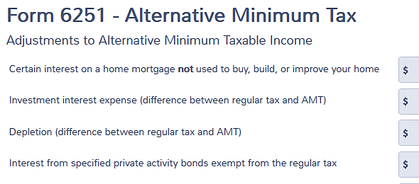
Entering Private Activity Bond Interest Income
Add up amounts from all 1099 forms and enter total
Make a note on intake form for reviewer

Slide 47
Interest or Dividend Income
Complete one 1099 form at a time
Input all information on the form
If brokerage statement, input all information on the brokerage statement
Too easy to miss items if try to go back to a form a second time

Slide 48

Interest Income Quiz
Is interest taxable on federal return?
New York City bond interest?
Treasury bill interest?
Ford Motor Co bond interest?
Interest on loan to cousin Charlie?
No
Yes
Yes
Yes

Slide 49
Dividend Income Quiz
Dividends reinvested in more shares are not taxable (true or false)?
  False – the dividend income is the first transaction and the purchase of shares is a second transaction
Notes:
Emphasize
Whether or not reported on a 1099, taxpayer must report all their income

Slide 50
Dividend Income Quiz
Payers of dividends of less than $10 don’t have to issue 1099 (true or false?)
  True – same rule as for interest payers
Taxpayers don’t have to report dividends if they don’t get a 1099 form (true or false?)
  False – all income must be reported on the tax return
Check Intake Form
Notes:
Emphasize
Whether or not reported on a 1099, taxpayer must report all their income

Slide 51
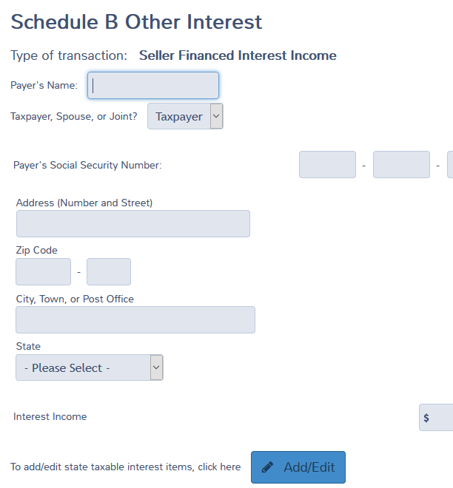
Seller-financed Mortgage
Interest
Reported on Sch B top portion
Must have payer ID number to e-file
Is it not taxable for your state?

Slide 52
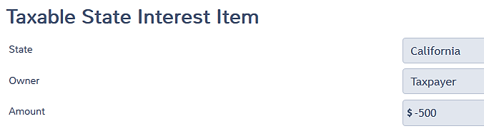
Seller-financed Mortgage
Interest
If exempt for state, enter as negative number

Slide 53
Foreign Income or Account?
Must ask and answer questions at bottom of Sch B
  Foreign account/signature authority
  Foreign trust
If answer is “yes” to either, additional reporting may be required
Remind taxpayer of additional filing responsibility – and maybe refer to paid preparer
Notes:
Emphasize
Usually the questions are defaulted to “no”
If there is foreign interest income, must ask the questions and correct the answers
A mutual fund that reports “foreign income” is not the same
Mutual fund interest income is in scope and is not a foreign account (normally)
Substantial penalties for not filing the foreign account forms: FinCen114 and/or Form 8938 (both out of scope)

Slide 54
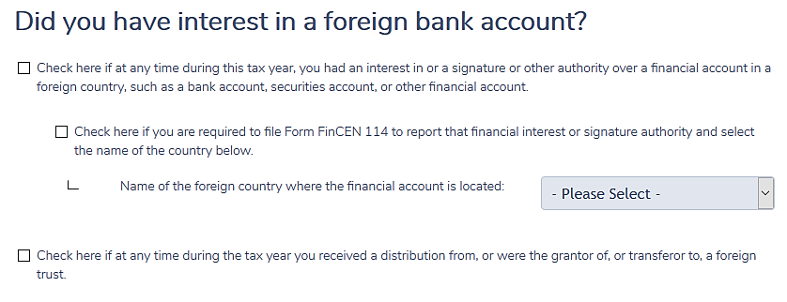
Foreign Account?
AN
^
Does not matter whether there is current income or not – must report the account
Notes:
Read questions carefully – signature authority over a foreign account also has to be reported.

Slide 55

Other Item: 1099-INT, -OID, or -DIV
Investment expenses
  1099-INT box 5
  1099-OID box 9
  1099-DIV box 5
Possible itemized deduction
  Schedule A, Line 23
  Subject to 2% of AGI threshold
Input now so don’t forget
More to be covered in deductions lesson
Investment interest is different and is OOS
Notes:
Emphasize
Do not reduce income amounts for investment expenses
No benefit if taking standard deduction
Cannot be investment interest – entirely different subject
Investment interest is out of scope!
Investment expenses:
Safety deposit box fee is an investment expense only if it is used to hold investments, e.g stock certificates
If used for personal items only, e.g. jewelry, not deductible
Management or account fees
Must be paid from taxable account
Fee paid within an IRA is not deductible
Will reduce IRA assets eventually taxed when distributed

Slide 56
Quality Review
Interest or Dividend Income
Check Intake/Interview Sheet – was interest/dividend box checked?
Verify interest or dividend income is
entered correctly
  Including any interest or dividend received with no paperwork
State adjustments?
Notes:
Emphasize
If taxpayer still has the account
Confirm that no interest or dividend this year
Many taxpayers have direct stock holdings (not in a brokerage account)
Easy to miss (or lose) one

Slide 57
Quality Review Interest/Dividend Income
Compare to prior year
  Missing accounts?
Foreign tax credit or deduction?
Miscellaneous investment expense entered?
Any other interest or dividends?

Slide 58
Foreign Accounts or Specified Financial Assets– Special Note
If any FATCA box is checked OR if taxpayer has foreign accounts at or over $50,000, advise taxpayer that there are substantial penalties for not filing the required forms
Refer taxpayer to a paid professional, especially if there are filing failures in the past
Notes:
See form 8938 instructions for the definition of a specified foreign financial asset – it is not limited to bank or brokerage accounts.

Slide 59



Interest and Dividend Income
Comments
Questions

